Slide 1
Designing and Developing PowerApps Portals
Notes:
This module introduces students to the Microsoft Power platform and explains the role of canvas apps, connectors and flows in building business solutions. The module introduces the Common Data Service for Apps (CDSA) and explains how it provides support for creating custom entities and building model-driven apps. Students will create canvas apps with PowerApps Studio and learn to write advanced expressions for screen and control properties. The module examines connectors and data binding and demonstrates using the Start with Data template. Along the way students will learn to build a canvas app for mobile devices that reads and writes customer data to a table inside an Excel workbook in OneDrive for Business.

Slide 2
Agenda
PowerApps Portal Architecture
Portal Editor
Portal Management App
Portal Configuration
Developing Web Templates

Slide 3
PowerApps Portals
PowerApps portals provide web development platform
Create websites for anonymous users and/or authenticated user
Allows for authentication through LinkedIn, Facebook, Twitter, etc.
Portal content managed by business users
Portal Editor used to add pages and author content
Portal Management app created along with portal
Portal can be customized by web developers
Portal can be extended with custom web templates
Web templates can be written to access CDS entities

Slide 4
PowerApps Portal Architecture
PowerApps portals built on Common Data Service
You must create a environment with CDS database to create portal
CDS used to track data for pages, templates an site content
Creating portals triggers installation of several ADX solutions
PowerApps Environment
PowerApps Environment
Portal 1
Portal 2
CDS Database
CDS Database

Slide 5
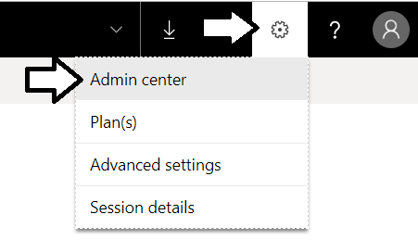
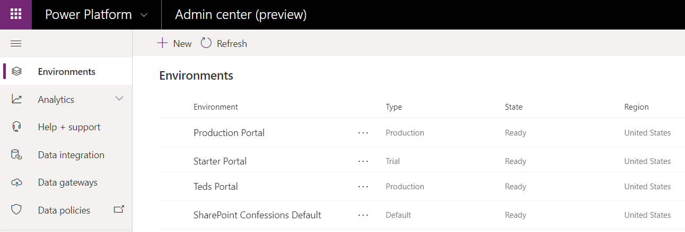
This Isn't Your Fathers PowerApps Admin Center
Navigate to the new PowerApps admin center
Admin center allows you to create and manage environments

Slide 6
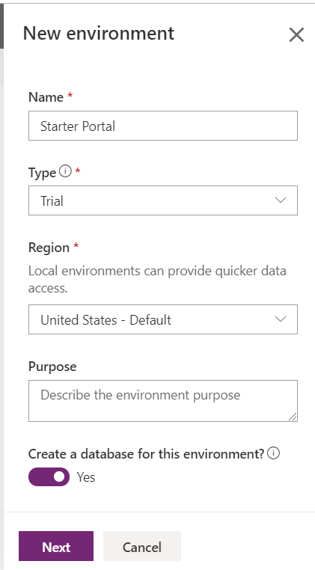
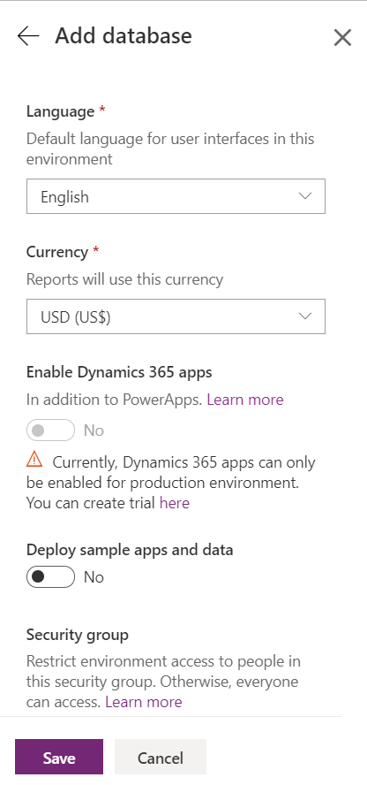
Creating a New Environment
Use New command in the new admin center

Slide 7
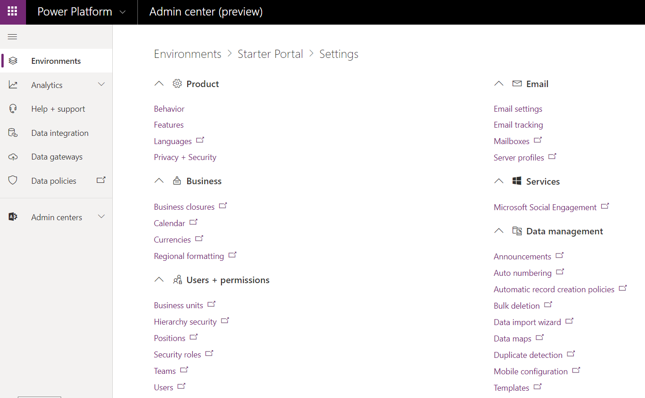
Configuring Environment Features

Slide 8
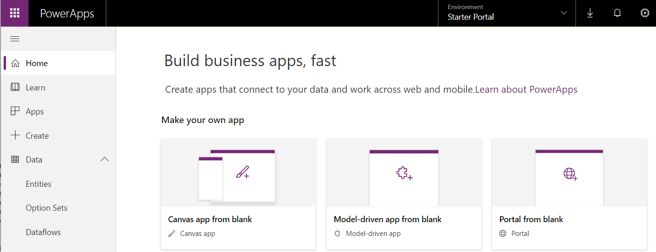
Creating a New PowerApps Portal
New portal created using PowerApps Maker Portal
Select your target environment
Create portal using Portal from blank template

Slide 9
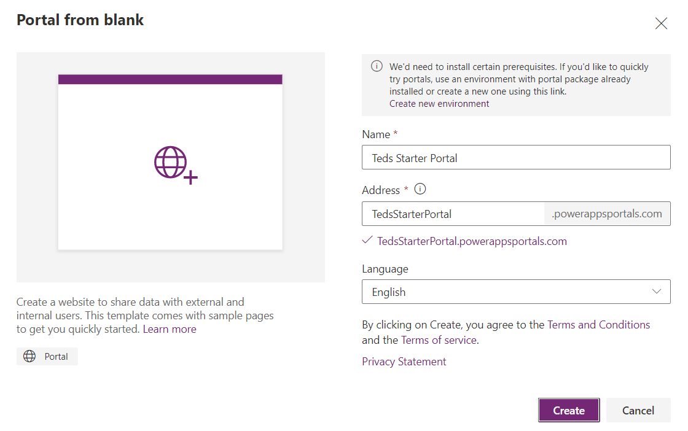
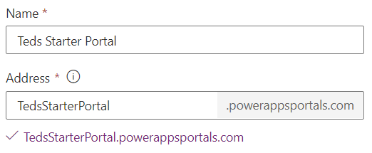
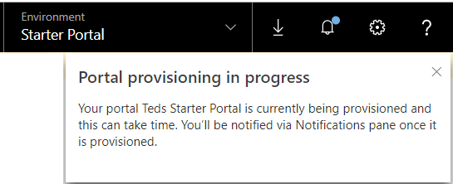
Providing Portal Provisioning Data
Portal requires Name and unique address

Slide 10
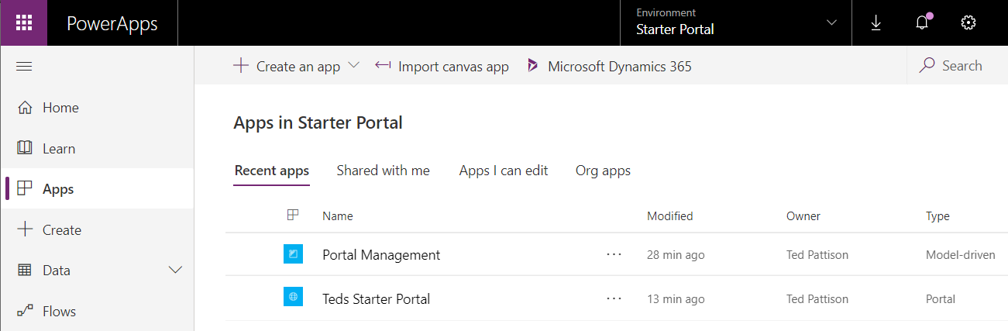
Portal Apps
Provisioning a portal creates two applications
PowerApps portal
Model-driven app named Portal Management

Slide 11
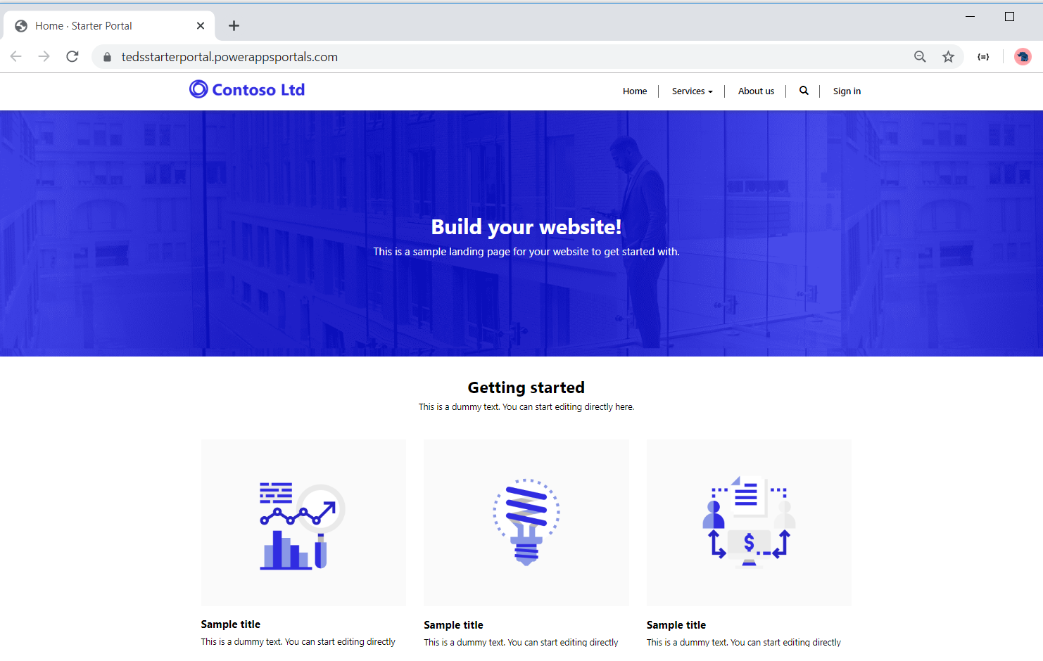
Launching the Portal

Slide 12
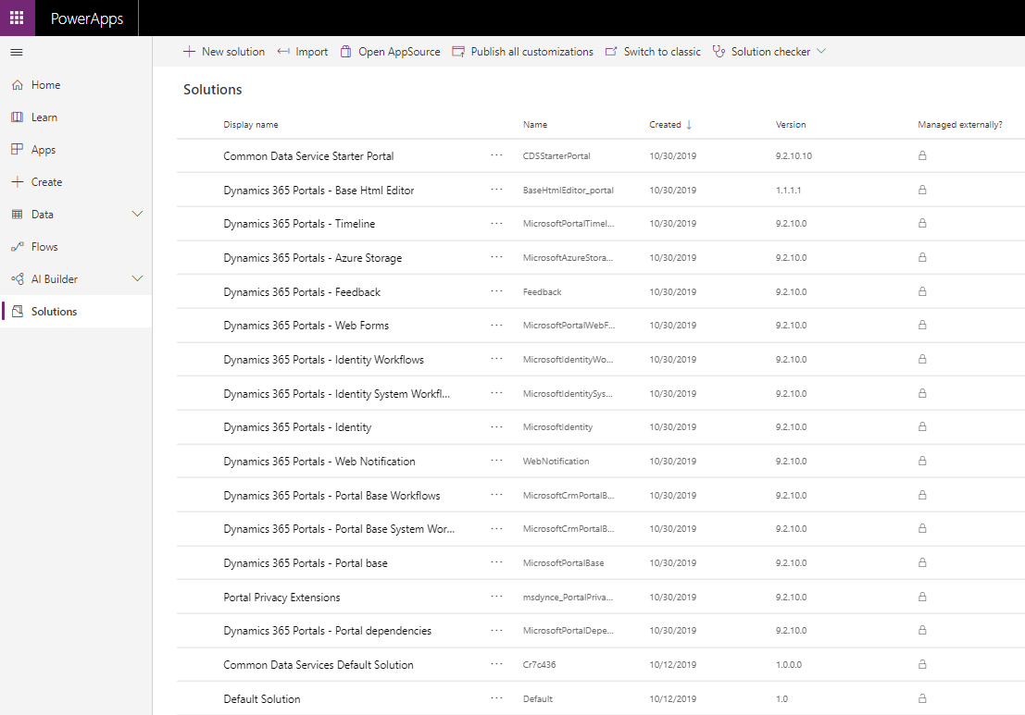
Solutions Installed to Support Portals
Creation of portal triggers installation of ADX solutions

Slide 13
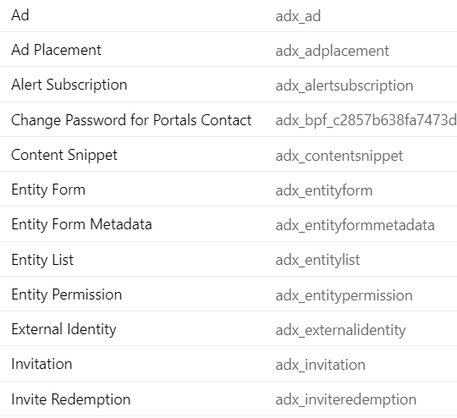
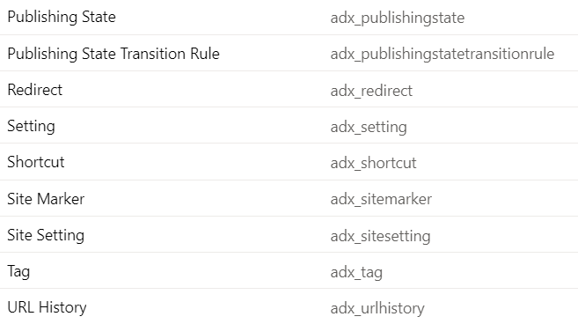
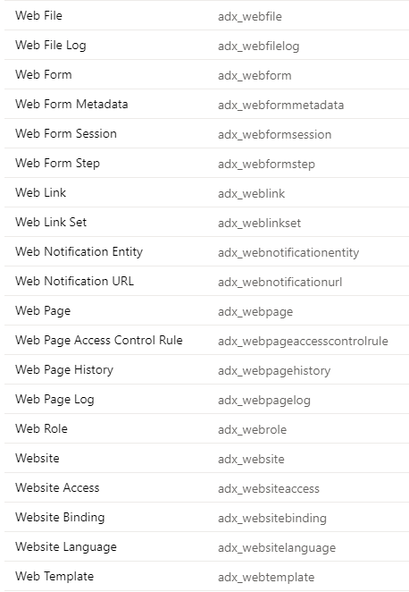
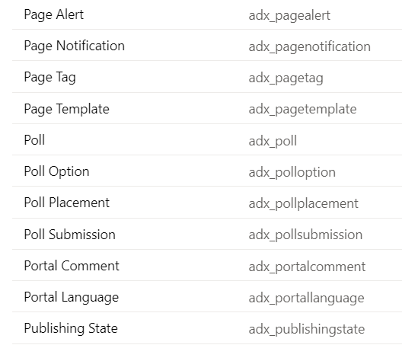
PowerApps Portal Entities

Slide 14
Portal Templates
Customer self-service portal
Provides customers with access info, support resources and order status
Partner portal
Provides portal for with resellers, distributors, suppliers and/or partners
Employee self-service portal
streamline common tasks and allows for sharing resource
Community portal
Facilitates interactions between customers and experts
Portal from blank
Minimum portal with a small set of sample pages

Slide 15
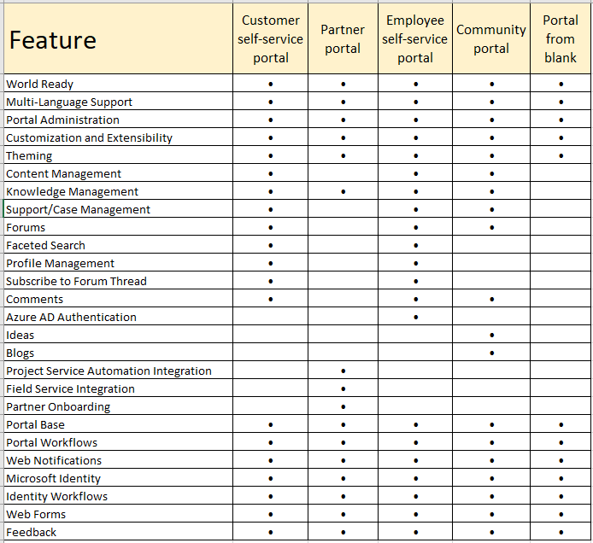
Portal Template Features

Slide 16
Agenda
PowerApps Portal Architecture
Portal Editor
Portal Management App
Portal Configuration
Developing Web Templates

Slide 17
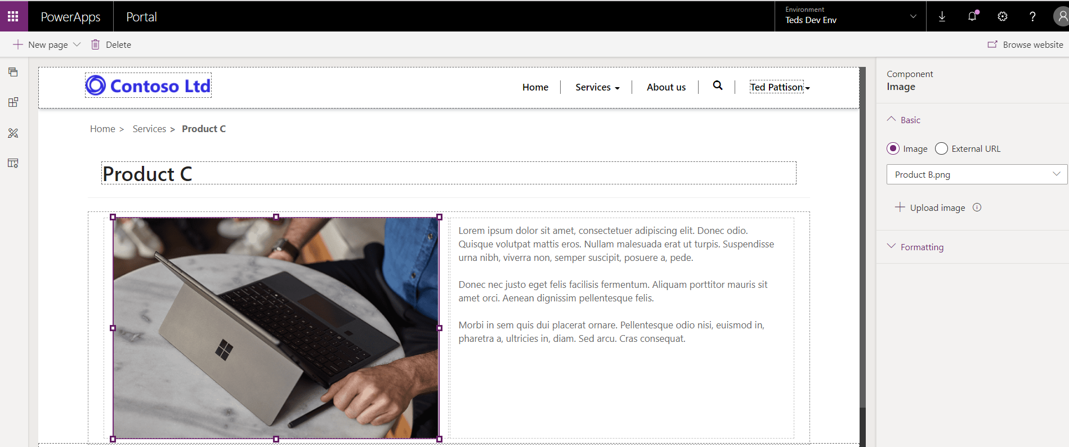
Portal Editor
Used to add pages and author page content
Designed for less-technical users
Editor not require web designer/developer skills

Slide 18
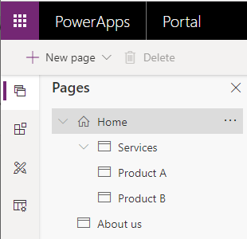
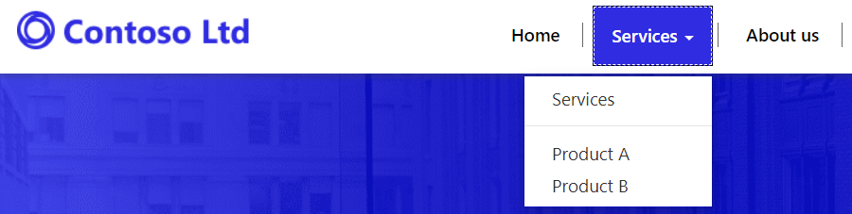
Page Hierarchy
Web Page can have one or more child pages
Provides foundation for building page hierarchy
Page hierarchy used to build navigation menu

Slide 19
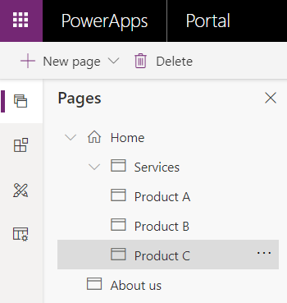
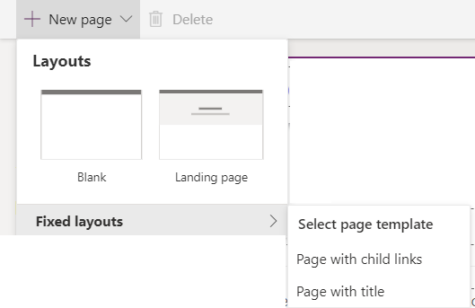
Adding and Navigating Pages
Pages tab provides navigation across pages
Pages added using New page menu button

Slide 20
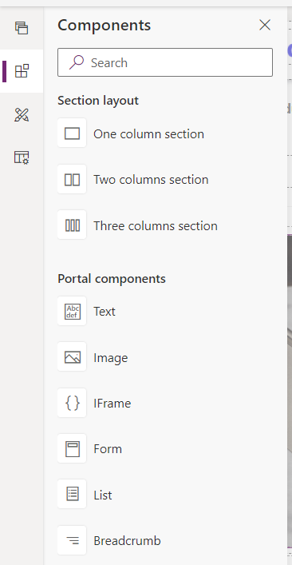
Adding Page Content using Components
Portal Editor provides Components for content authors
You drag components onto page design surface

Slide 21
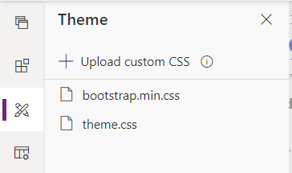
Themes
PowerApps portals styled using Bootstrap 3
Not practical to use a more recent version of bootstrap (e.g. v4)
theme.css file is provided for your custom styles

Slide 22
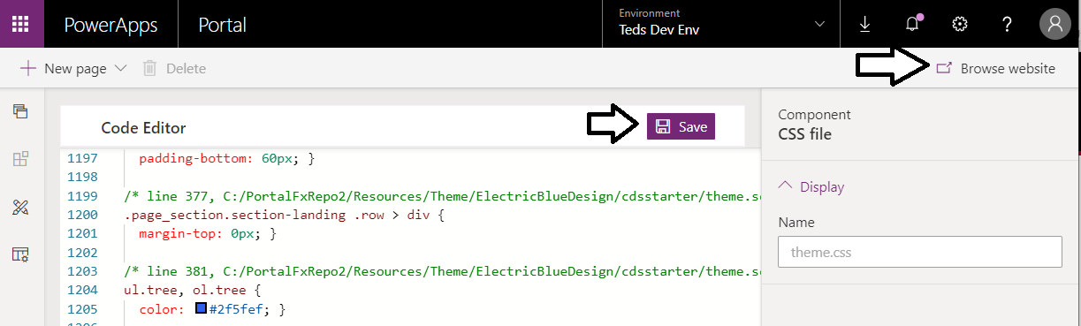
Seeing Your Changes in the Portal
Portal Editor provides Browse website button
Used to test how the portal will appear to others
Browse website clears cache to enabled development

Slide 23
Agenda
PowerApps Portal Architecture
Portal Editor
Portal Management App
Portal Configuration
Developing Web Templates

Slide 24
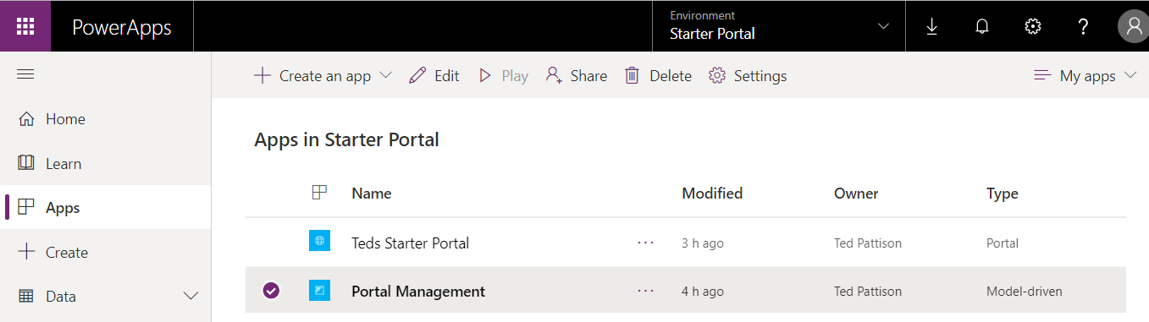
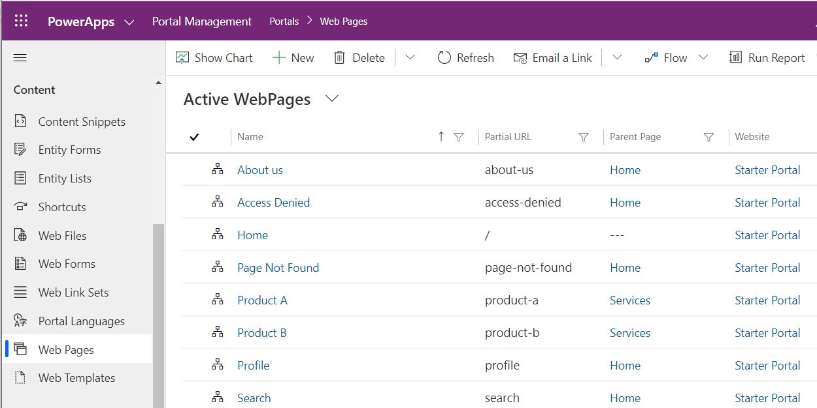
Portal Management App

Slide 25
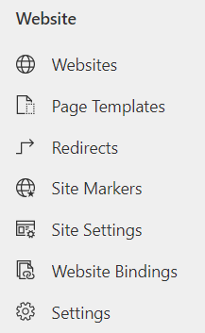
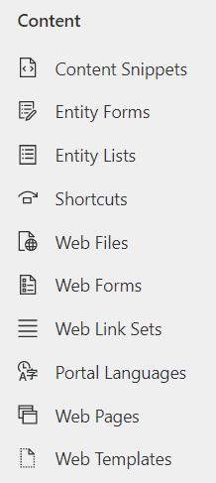
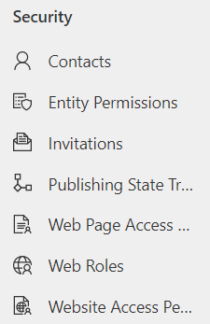
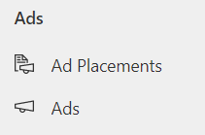
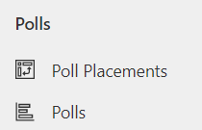
Portal Management App Entities
Portal Management app provides access to portal entities
Website entities
Content entities
Security entities
Ad and Poll entities

Slide 26
Agenda
PowerApps Portal Architecture
Portal Editor
Portal Management App
Portal Configuration
Developing Web Templates

Slide 27
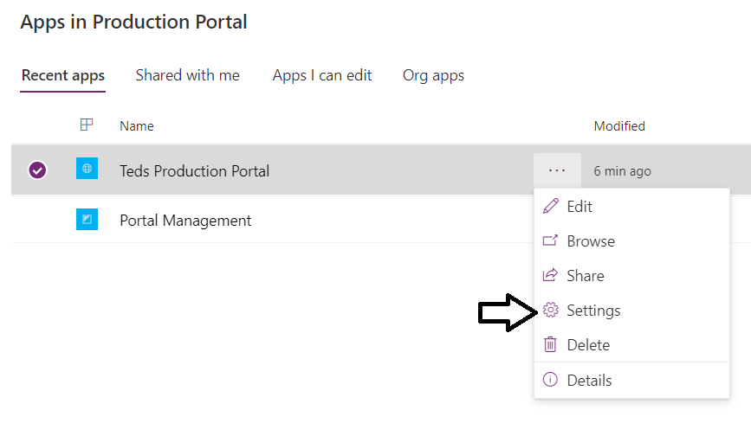
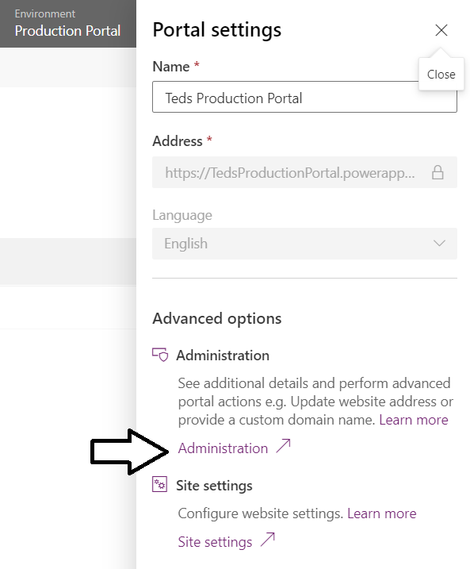
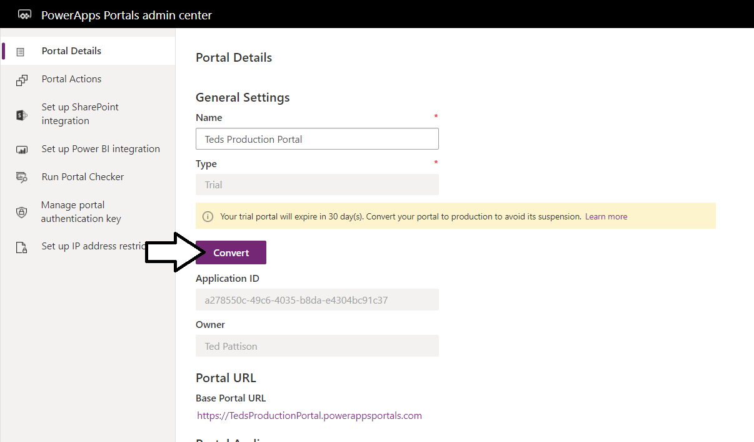
Navigating to the Portal admin center

Slide 28
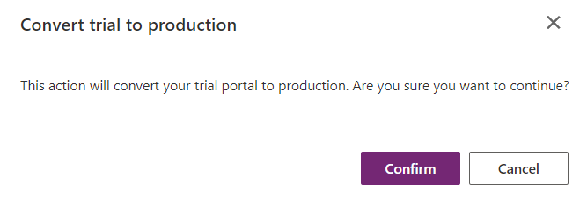
Converting from Trial to Production
Portal is created in trial mode
Portal must be converted to production mode within 30 days
Host environment must be in production mode to convert portal
Important configuration options not available in trial portal

Slide 29
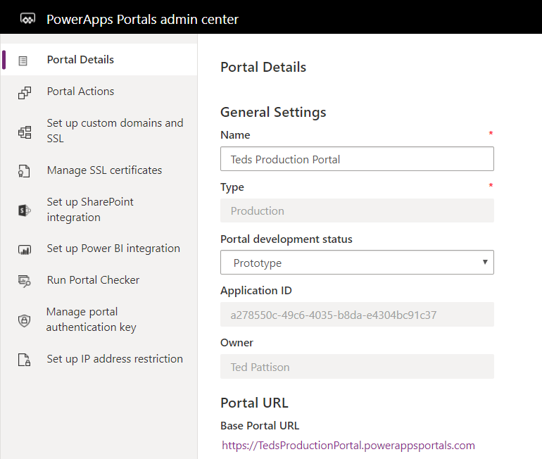
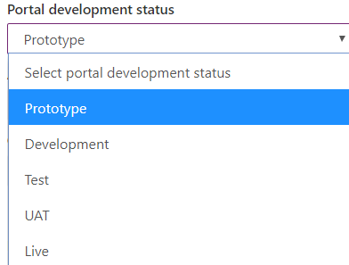
Portal Development Status
Production portal has develop status property

Slide 30
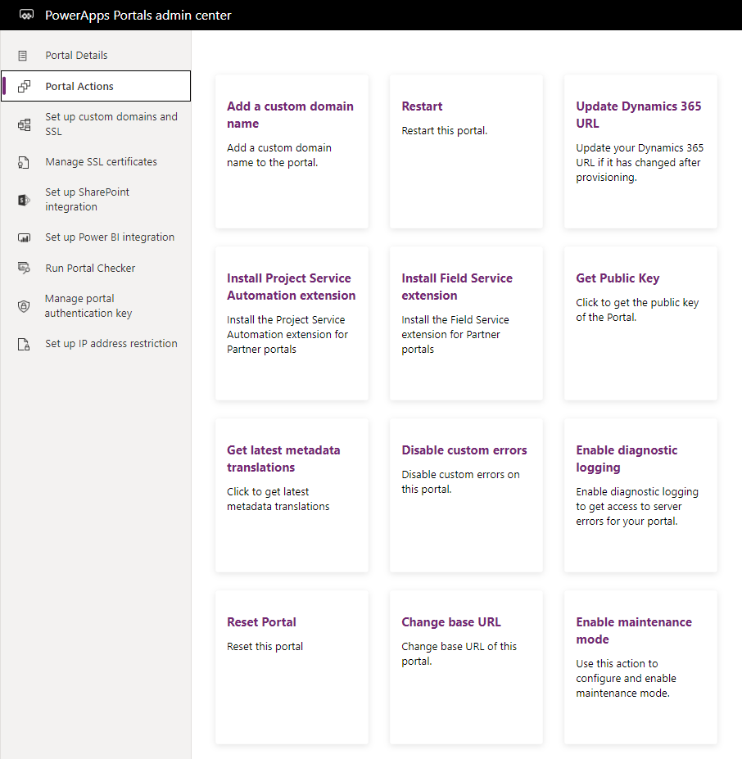
Portal Actions
Import portal actions
Add custom domain
Configure SSL
Enable SharePoint Integration
Enabled Power BI Integration
Restart Portal
Reset Portal

Slide 31
Integrating External Authentication Providers
PowerApps portals allows for external authentication providers
Users can authenticate using LinkedIn, Facebook and Twitter
Brian Knight (MVP) has some very useful videos
PowerApps Portals External Authentication with LinkedIn https://www.youtube.com/watch?v=8Zx2RBhwV4I
PowerApps Portals External Authentication with Facebook https://www.youtube.com/watch?v=egfnaXIqpwU

Slide 32
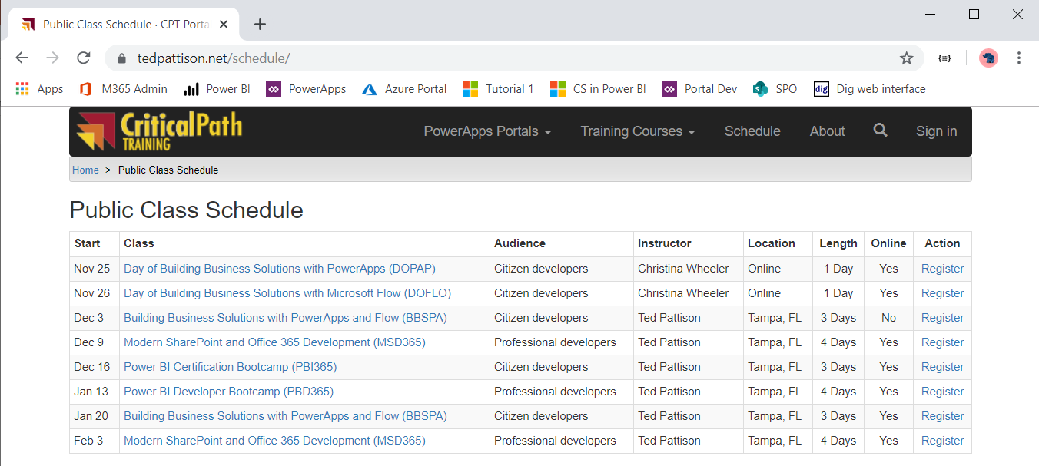
Demo Portal at www.TedPattison.net

Slide 33
Agenda
PowerApps Portal Architecture
Portal Editor
Portal Management App
Portal Configuration
Developing Web Templates

Slide 34
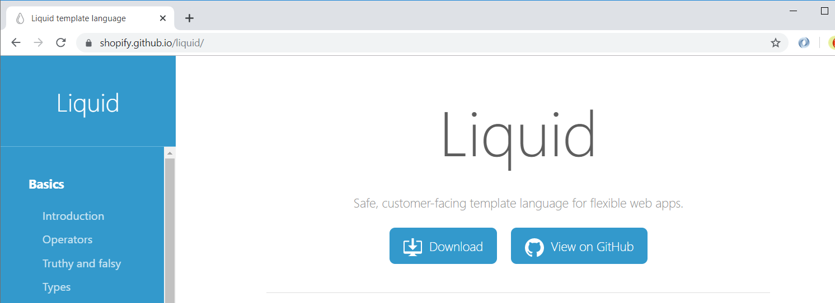
Liquid Template Language
Liquid is open-source template language
Created by Shopify in 2006
Currently used by 100s of websites and ISVs
Designed to surface data from databases into web pages
Liquid template code runs in the cloud in secure manner
Docs and tutorial available at https://shopify.github.io/liquid/

Slide 35
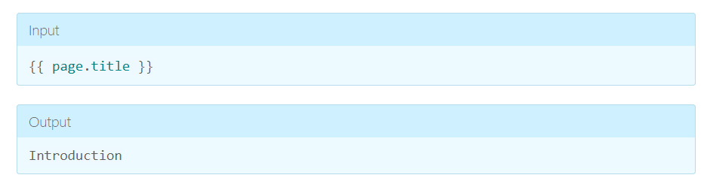
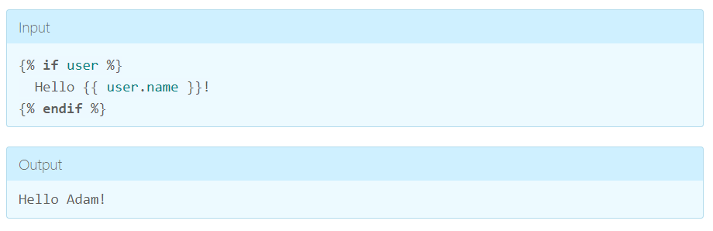
Liquid 101 – Objects and Tags
Objects and variables denoted by double curly braces: {{ and }}
Tags with logic use curly braces and percent signs: {% and %}.

Slide 36
Liquid Objects
The follow Liquid objects are available in PowerApps portals
PowerApps-specific reference for Liquid template language
https://docs.microsoft.com/en-us/powerapps/maker/portals/liquid/liquid-overview
now | A date/time object that refers to the current UTC time at the time the template is rendered.
page | current portal request page with title and URL
params | request.params
request | Contains information about the current HTTP request. More information: request
settings | Allows you to load any Site Setting by name. More information: settings
sitemap | Allows access to the portal site map. More information: sitemap
sitemarkers | Allows you to load any Site Markers by name. More information: sitemarkers
snippets | Allows you to load any Content Snippet by name. More information: snippets
user | Refers to the current portal user. If no user is signed in, this variable will be null.
weblinks | Allows you to load any Web Link Set by name or ID. More information: weblinks
website | current portal Website record with website properties

Slide 37
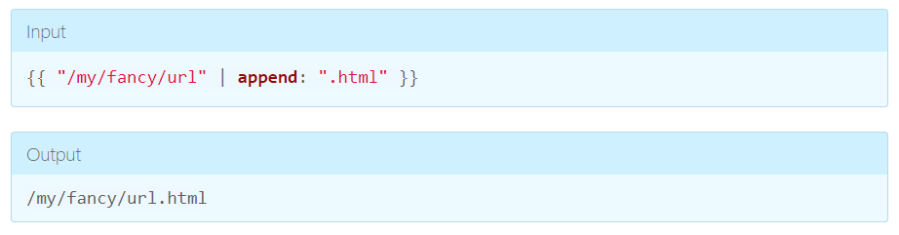
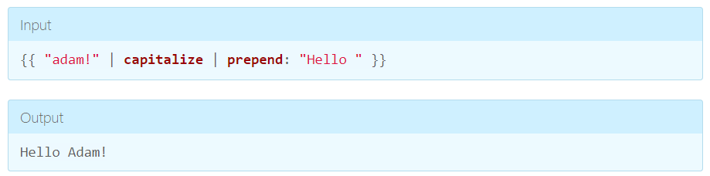
Liquid 101 - Filters
Filters transform objects and are separated by a |

Slide 38
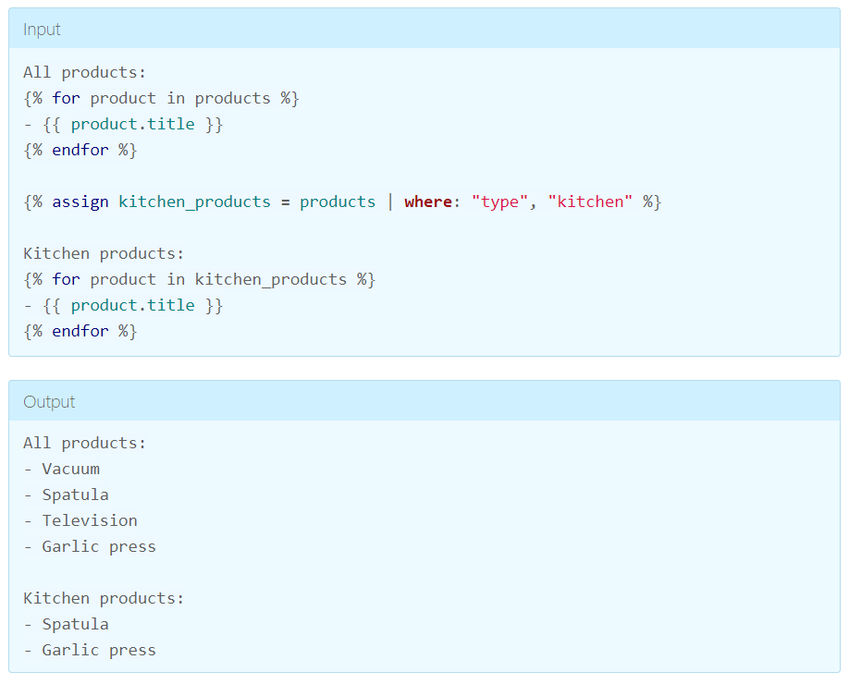
Liquid 101 – where filter
where can be used to filter records

Slide 39
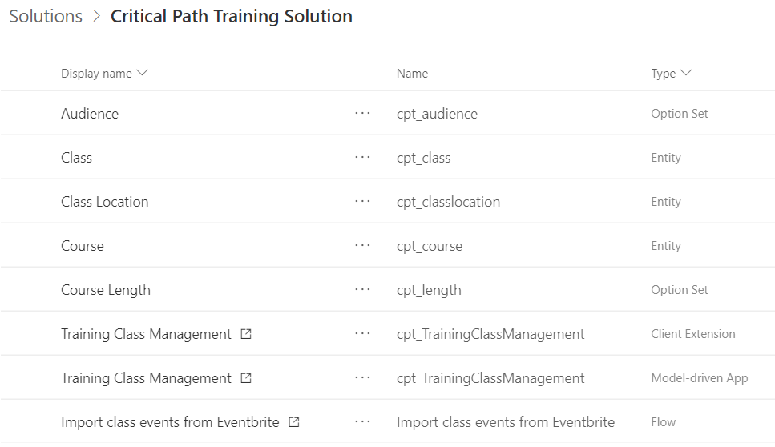
Creating a Solution with Custom Entities

Slide 40
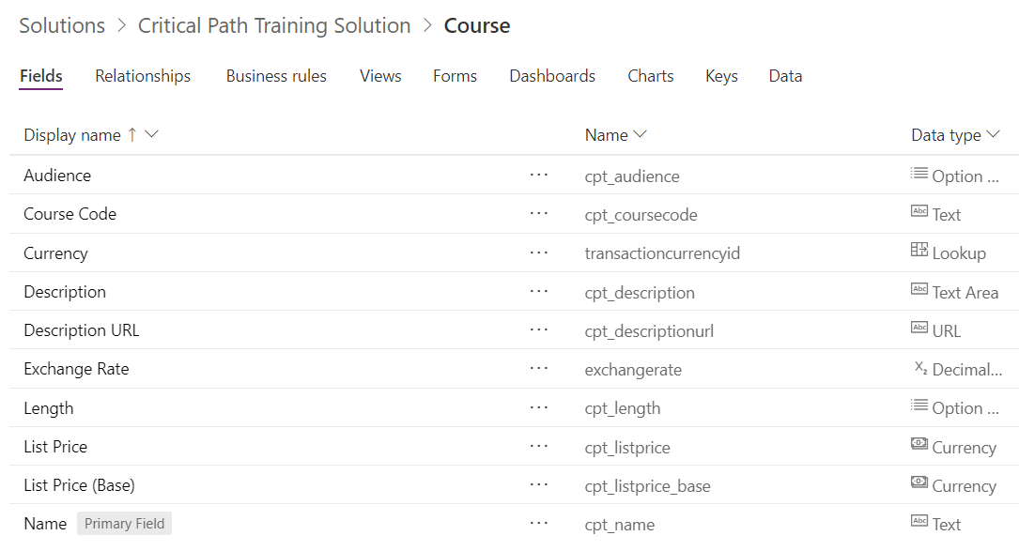
The Course Entity

Slide 41
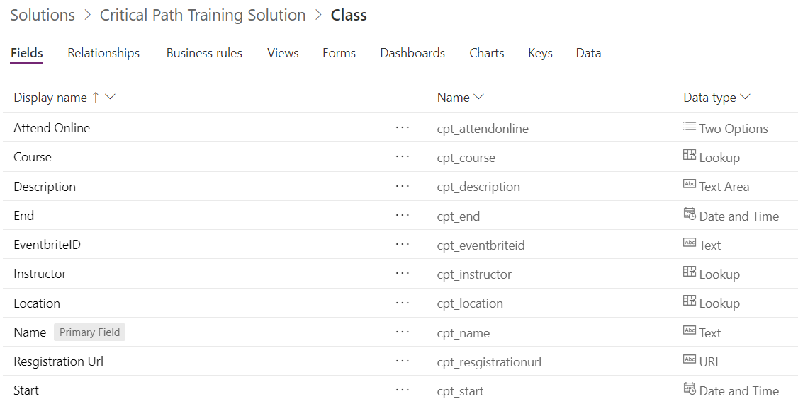
The Class Entity

Slide 42
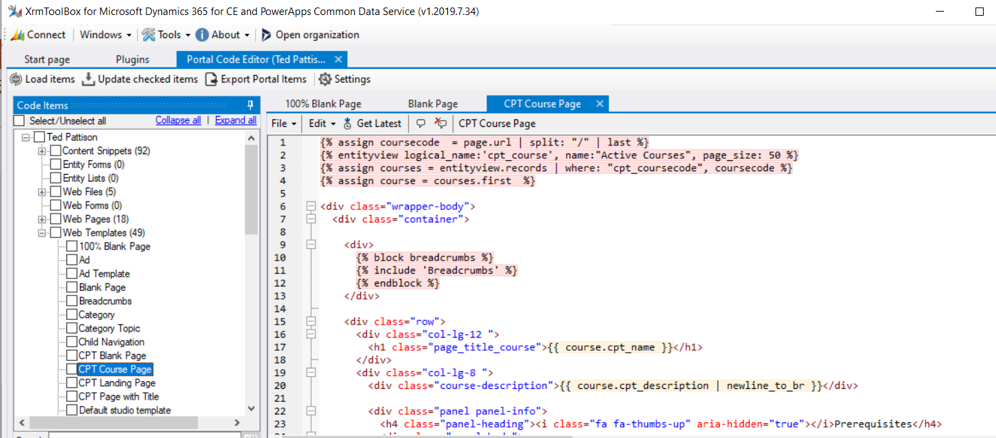
XrmToolbox
Authoring Tool for PowerApps Portals
Provides plug-ins for authoring and managing portals

Slide 43

Using Liquid to Access Entity Data
Web Template created using Liquid scripting language
Can be used to access CDS data

Slide 44
Summary
PowerApps Portal Architecture
Portal Editor
Portal Management App
Portal Configuration
Developing Web Templates

Slide 45


Slide 46


Slide 47


Slide 48


Slide 49


Slide 50


Slide 51


Slide 52


Slide 53


Slide 54


Slide 55


Slide 56


Slide 57


Slide 58


Slide 59


